Slide 1

NIIT
PYTHON PROJECT
VIDEO STREAMING SOFTWARE
FROM:KRISHNANAND
ANMOL SRIVASTAVA

Slide 2
PURPOSE OF SOFTWARE
TO TAKE SEARCH KEY-WORD FROM THE USER AND SEARCH THE KEY-WORD OVER YOUTUBE AND PLAY THE MOST APPROPRIATE VIDEO DIRECTLY WITHOUT THE HELP OF ANY EXTERNAL BROWSER

Slide 3
MODULES
NAME OF MODULES
1-TKINTER
2-URLLIB
3-VLC
4-PAFY
5-EASY GUI
6-YOUTUBE_DL
USED

Slide 4
ABOUT THE MODULES
1-TKINTER
4-PAFY
Tkinter is the standard GUI library for Python. Python when combined with Tkinter provides a fast and easy way to create GUI applications
Pafy - a Python library to download YouTube content and retrieve metadata
2-URLLIB
5-EASY GUI
The urllib module in Python 3 allows you access websites via your program. This opens up as many doors for your programs as the internet opens up for you.
EasyGUI is a module for very simple, very easy GUI programming in Python. EasyGUI is different from other GUI generators in that EasyGUI is NOT event-driven.
3-VLC
6-YOUTUBEDL
youtube-dl is a free and open-source command-line utility that you can use to download YouTube videos as well as integrate this functionality into your own software applications.
VLC is a free and open source cross-platform multimedia player and framework that plays most multimedia files as well as DVDs, Audio CDs, VCDs, and various streaming protocols.

Slide 5
PURPOSE OF DIFFERENT MODULES AND FOR WHAT WE HAVE USED

Slide 6
Add your title
TKINTER
1
FOR CREATING GRAPHICAL USER INTERFACE
URLLIB
2
URLLIB IS USED TO HANDEL REQUEST AND RESPONSE FROM THE SPECIFIED URL
VLC
3
VLC MODULE IS USED TO HANDLE AND DISPLAY THE VIDEO OBTAINED

Slide 7
Add your title
PAFY
4
PAFY MODULE IS USED TO OBTAINE THE VIDEO FROM THE DESIRED URL
EASYGUI
5
EASY GUI IS USED FOR GUI INTERFACE COMPONENT
YOUTUBE_DL
6
YOUTUBE DL MODULE IS USED HANDEL SEARCH FROM YOUTUBE

Slide 8
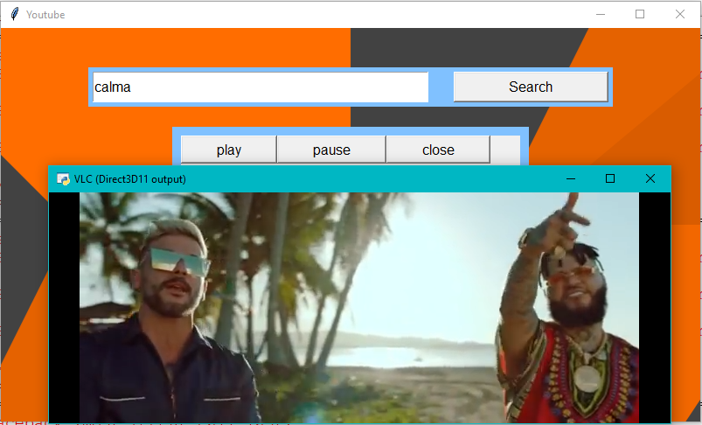
PREVIEW OF WORKING SOFTWARE

Slide 9
THANKS

